Slide 1
Introduction to MongoDB
Md. Sahidul Islam

Slide 2
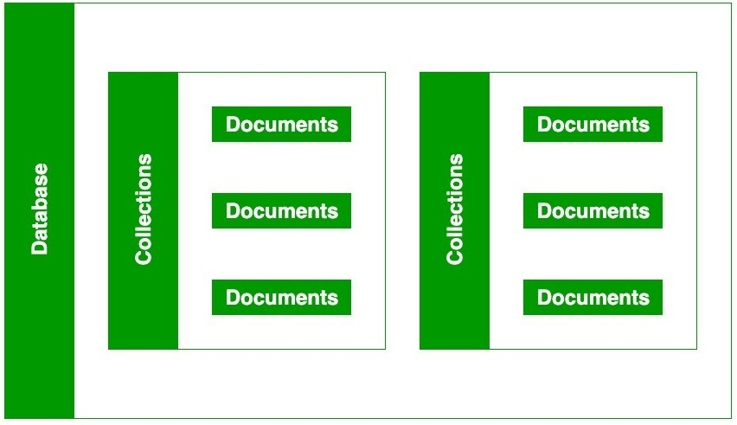
Mongodb
A source-available cross-platform document-oriented database program.
NoSQL database
JSON-like documents

Slide 3
Why mongo?
Document Model
Easy for developers to store structured or unstructured data
JSON format directly maps to native objects in most modern programming languages
Deployment Options
Get Started Quickly
Fully Scalable

Slide 4
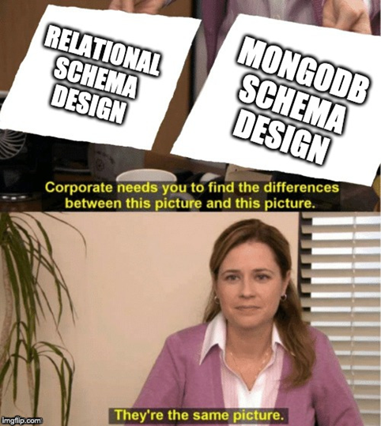

Relational VS Mongodb
Common thinking
BUT It’s a big

Slide 5
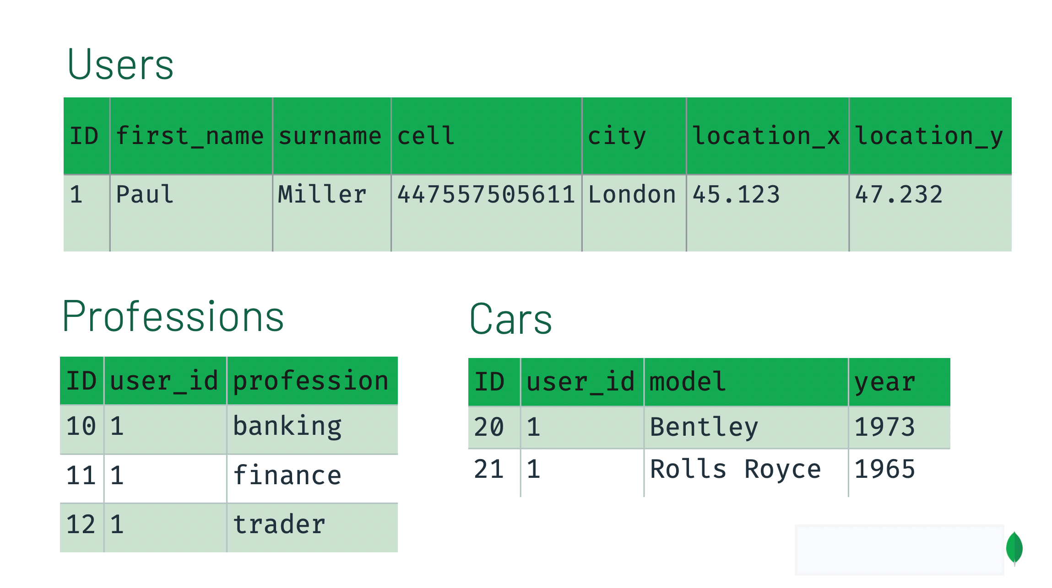
Relational Schema Design
Relational schema
Independent of queries
Less Redundancy

Slide 6

Mongo schema
No formal process
No algorithms
No rules

Slide 7
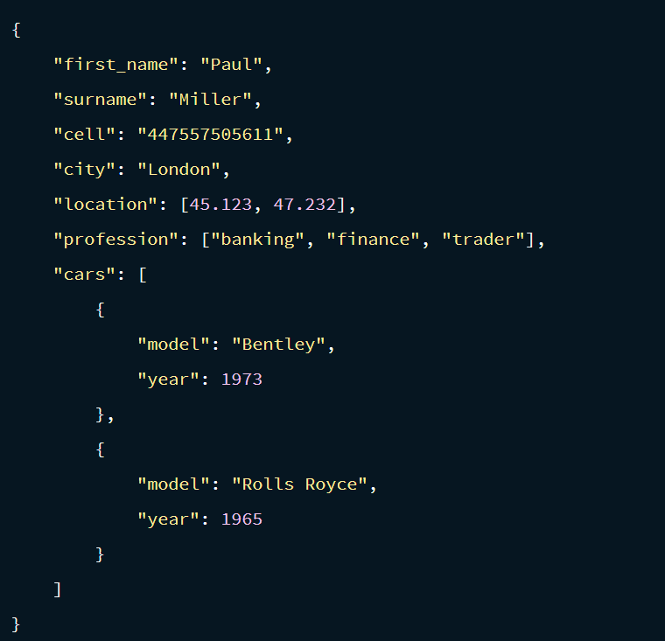
Mongo document

Slide 8
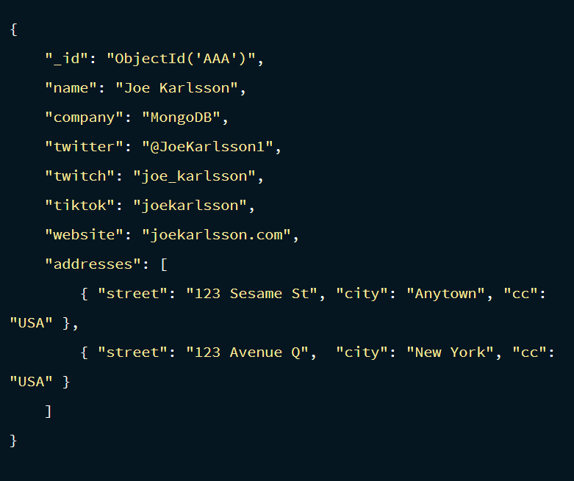
Data embedding

Slide 9
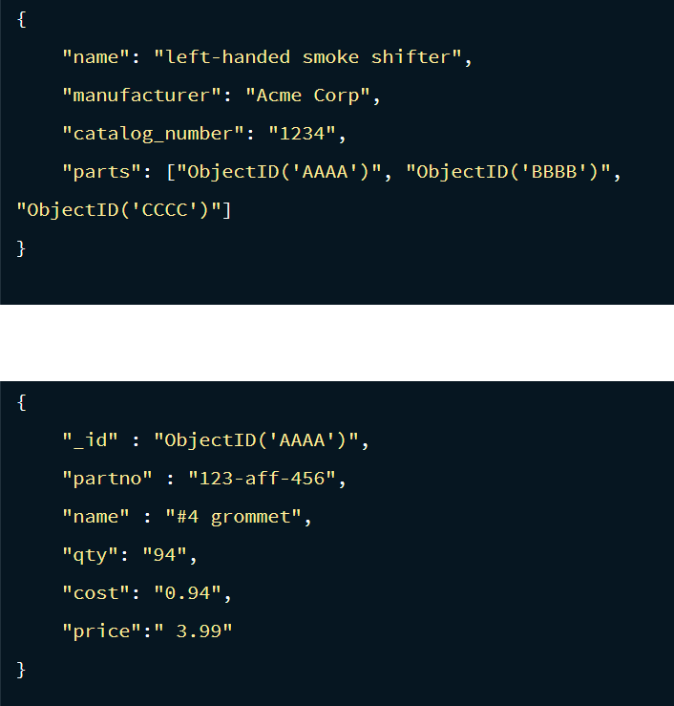
Data referencing

Slide 10
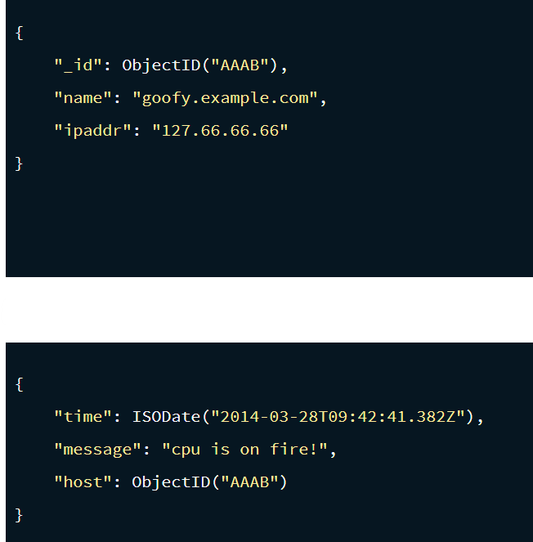
One to squillions

Slide 11
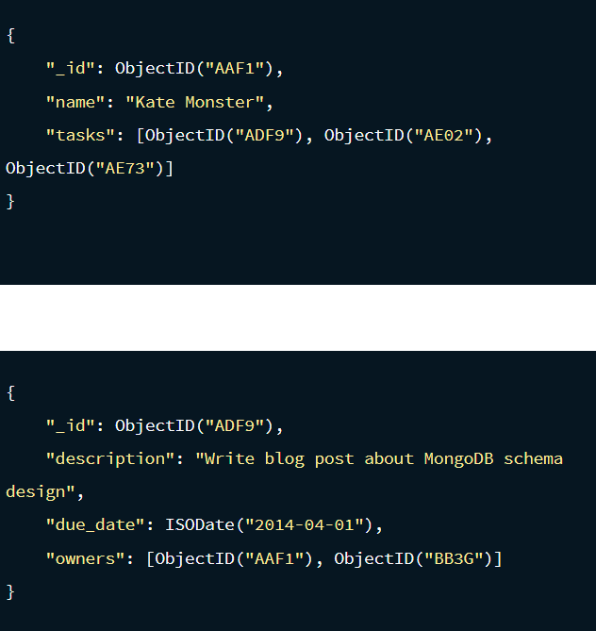
One to many

Slide 12
REcap
One-to-One - Prefer key value pairs within the document
One-to-Few - Prefer embedding
One-to-Many - Prefer embedding
One-to-Squillions - Prefer Referencing
Many-to-Many - Prefer Referencing

Slide 13
General rules
Rule 1: Favor embedding unless there is a compelling reason not to.
Rule 2: Needing to access an object on its own is a compelling reason not to embed it.
Rule 3: Avoid joins and lookups if possible, but don't be afraid if they can provide a better schema design.
Rule 4: Arrays should not grow without bound. If there are more than a couple of hundred documents on the many side, don't embed them; if there are more than a few thousand documents on the many side, don't use an array of ObjectID references. High-cardinality arrays are a compelling reason not to embed.
Rule 5: As always, with MongoDB, how you model your data depends entirely on your particular application's data access patterns. You want to structure your data to match the ways that your application queries and updates it.

Slide 14
DEMO

